Slide 1

Introduction to aws

Slide 2

Discussion:
What is cloud computing?

Slide 3
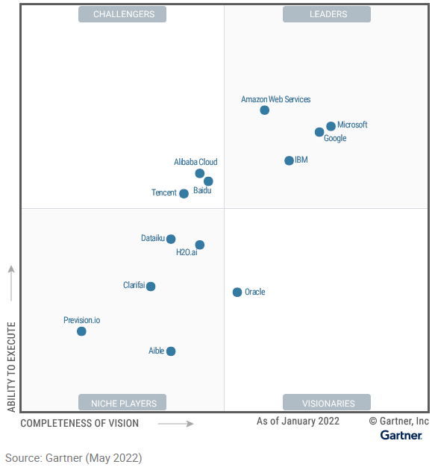

Cloud computing:
One of the leaders for 11 consecutive years in Magic Quadrant for Cloud Developer Services

Slide 4
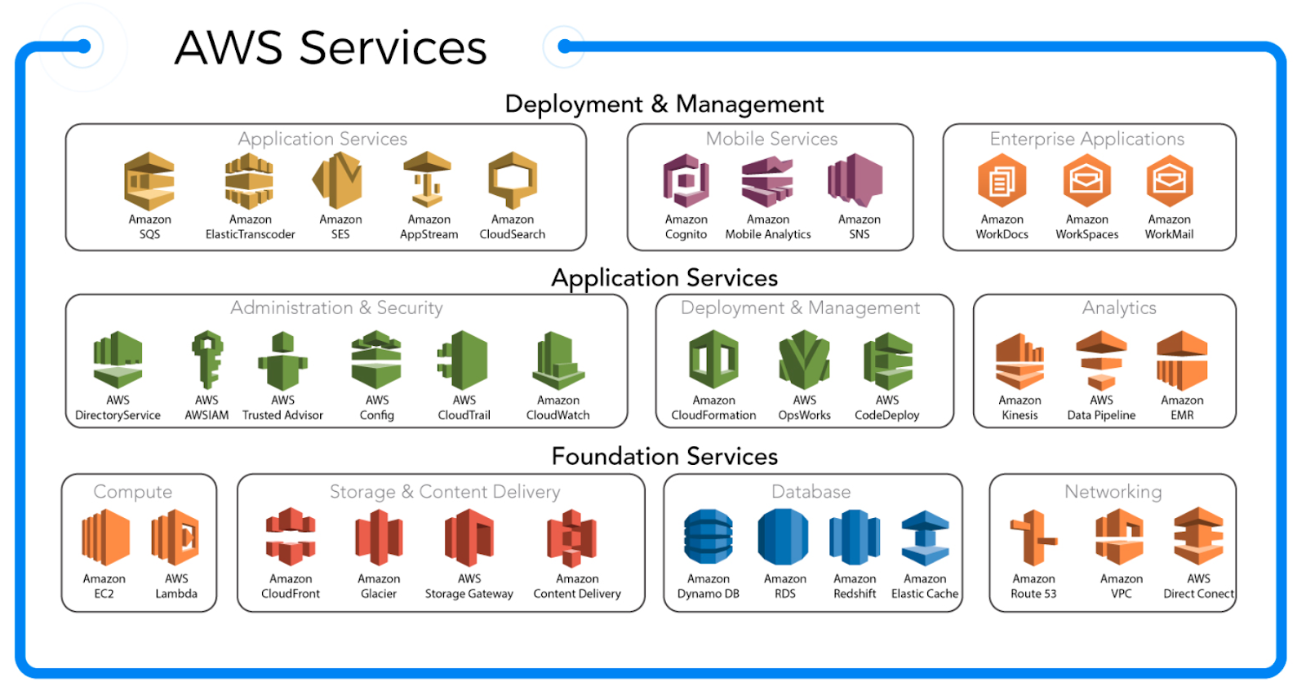
Amazon Web Services:

Slide 5
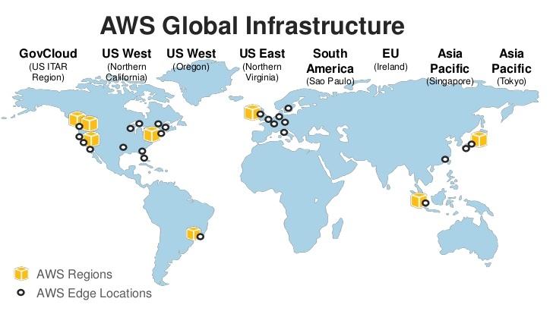
Amazon Web Services:

Slide 6
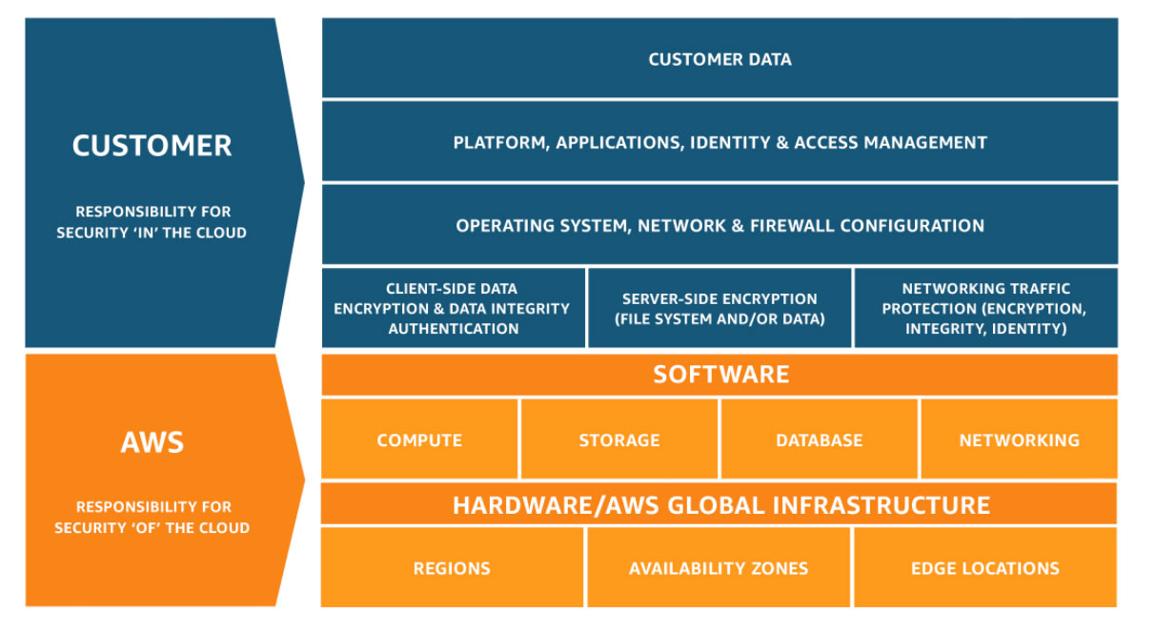
Amazon Web Services:
Shared responsibility model

Slide 7
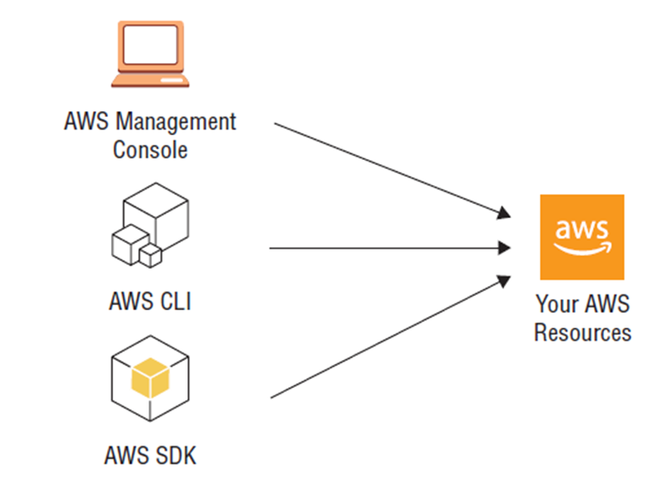
To Keep in mind

Slide 8

How to create an aws account

Slide 9
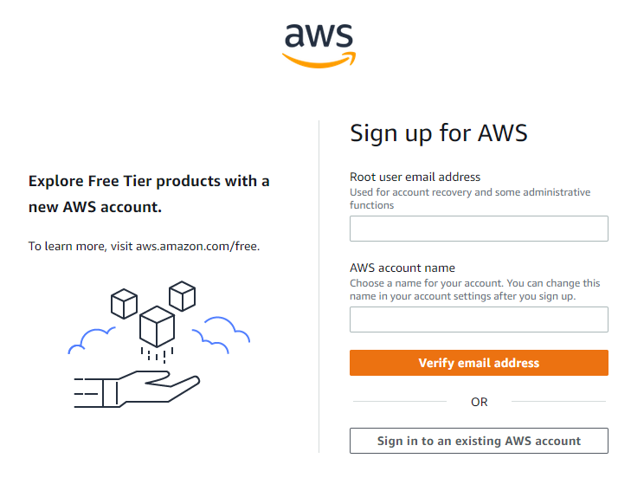
Creating the account:
Login to Amazon Web Services registration page
Enter your email address and
a name you want to give to the account
https://portal.aws.amazon.com/billing/signup#/start/email

Slide 10

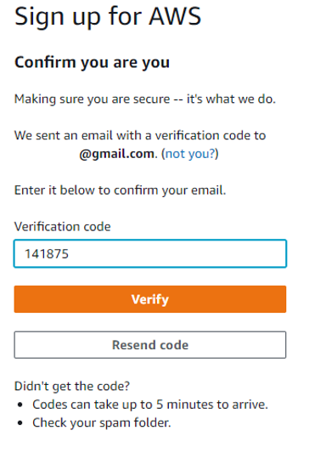
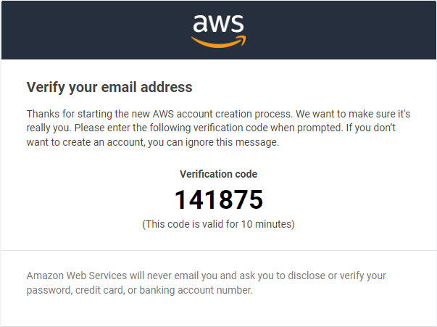
Creating the account:
You should receive an email to verify your account.
In this email, you will see a verification code, which you must enter in the form. After that, click on "Verify".

Slide 11
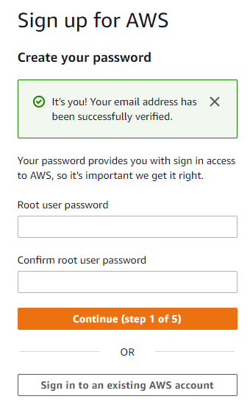
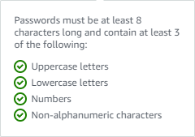
Creating the account:
In the form, enter a password that meets certain acceptance criteria.
Then click on "Continue".

Slide 12
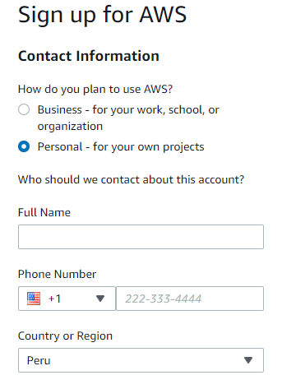
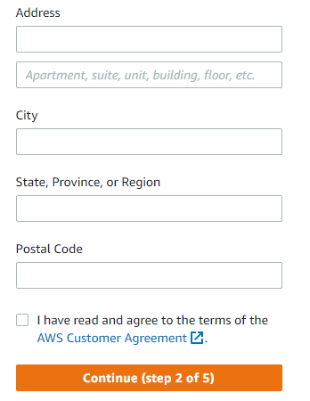
Creating the account:
In the form, check the "Personal: for own projects" option.
Enter your name, phone number, country, address, city, region and zip code.
Check the option of the AWS User Agreement terms. After that, click "Continue".

Slide 13
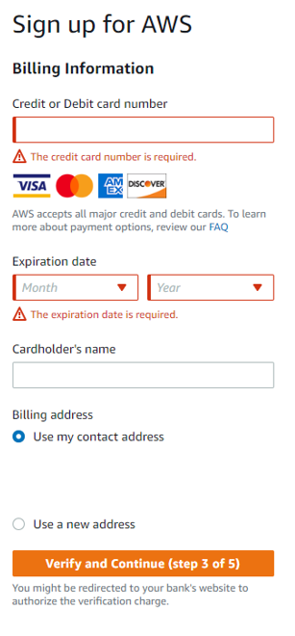
Creating the account:
On the form, enter credit or debit card information. After that, click on "Verify and continue".
Note: This action may result in a temporary hold of $1.00 USD or equivalent to verify your identity. It should be noted that the usage below the AWS free tier limits will not be charged, and for the purposes of this lab, the free tier limit will not be exceeded.

Slide 14
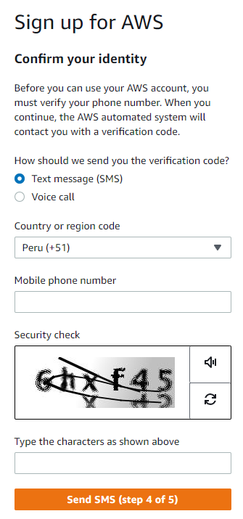
Creating the account:
In the form, enter the country code (+51), your cell phone number, the security check.
After that, click on "Send SMS".

Slide 15
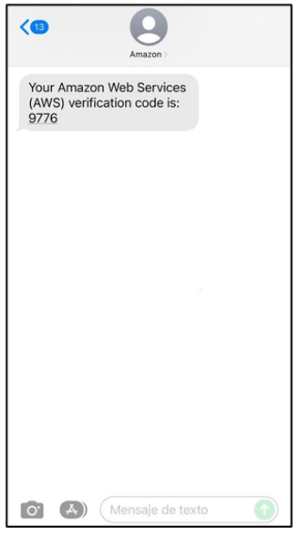
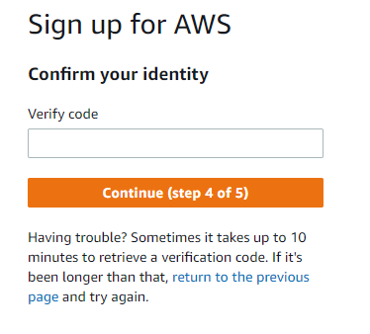
Creating the account:
Once you have received the SMS with the verification code.
Enter this code in the form. After that, click on "Continue

Slide 16
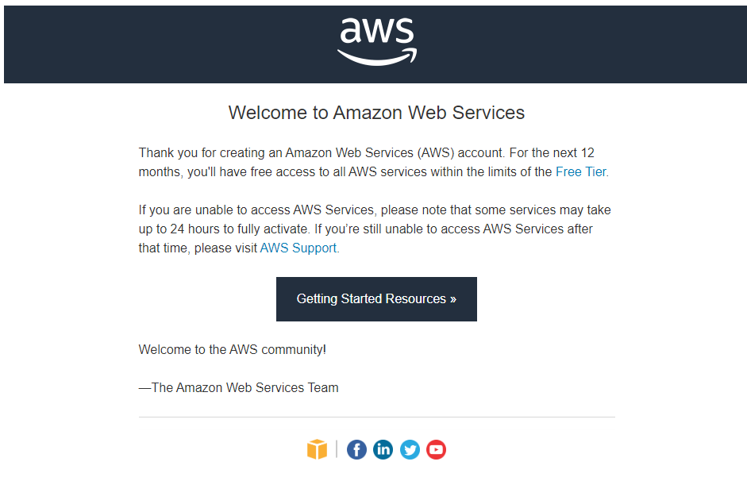
Creating the account:
Finally, you will receive a welcome email.

Slide 17
Free Tier on AWS

Slide 18
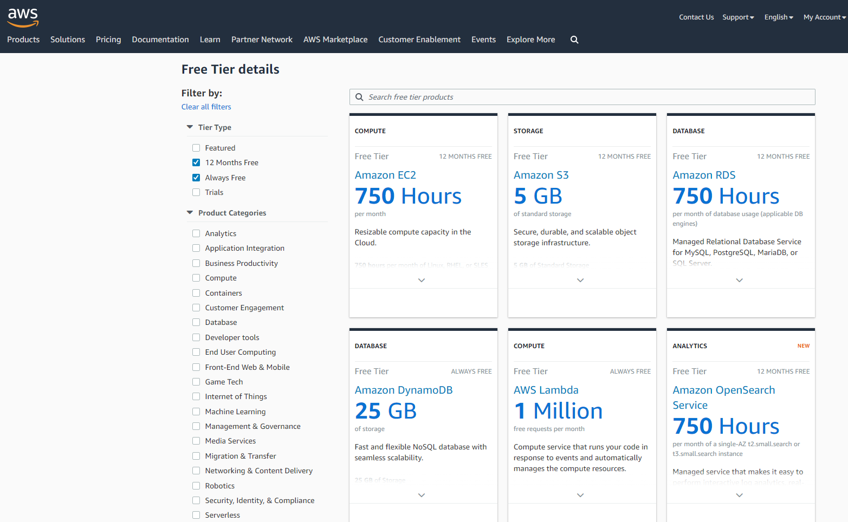
Free Tier on AWS
https://aws.amazon.com/free/?nc1=h_ls

Slide 19
Credits in AWS

Slide 20
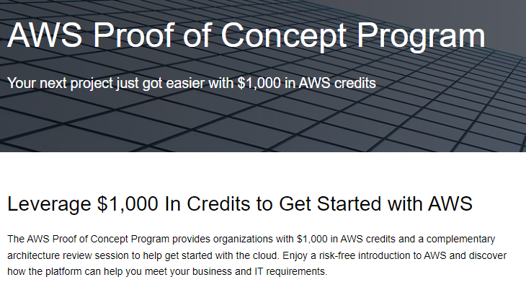
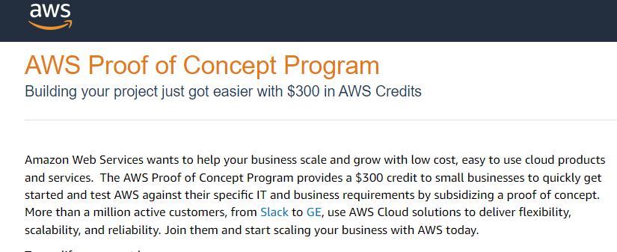
PoC:
https://pages.awscloud.com/GLOBAL-field-GF-Proof-of-concept-2022-interest.html

